Slide 1
OPERATING SYSTEMS
Process Synchronization
FBA

Slide 2
BACKGROUND
Processes can execute concurrently or in parallel
CPU scheduler switches rapidly between processes to provide concurrent execution
A process may be interrupted at any point in its instruction stream
Parallel execution, in which two instruction streams execute simultaneously on separate processing cores
We will explain how concurrent or parallel execution can contribute to issues involving the integrity of data shared by several processes

Slide 3
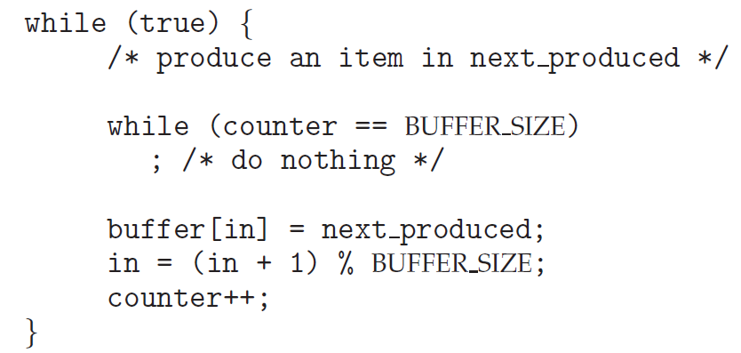
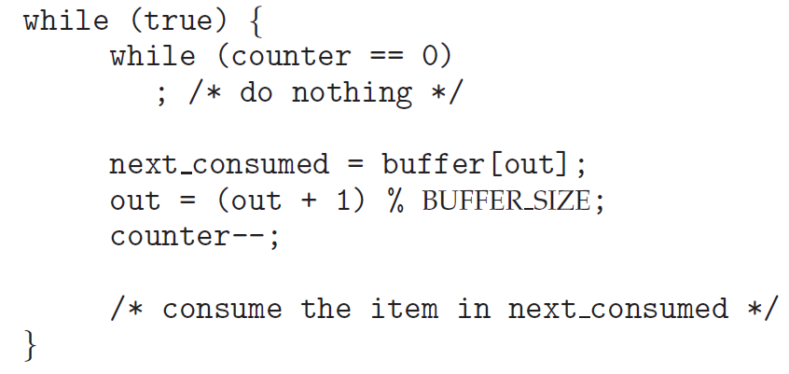
PRODUCER–CONSUMER PROBLEM
Modify the algorithm to remedy this deficiency - add an integer variable counter, initialized to 0
counter is incremented every time we add a new item to the buffer
decremented every time we remove one item from the buffer

Slide 4
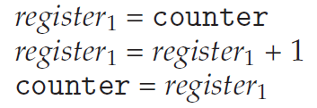
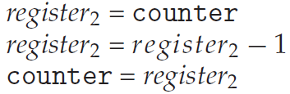
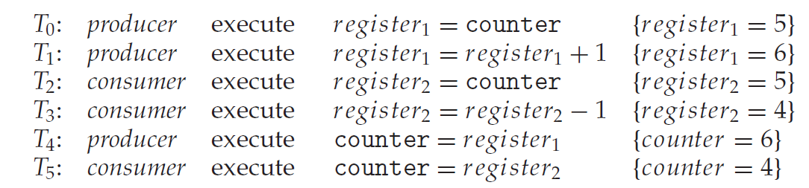
DATA INTEGRITY PROBLEM
“counter++” and “counter-- “ in machine language is like in the above.
register1 and register2 is local CPU registers.
Concurrent execution of “counter++” and “counter--” and allowing them to manipulate the counter variable create incorrect state.

Slide 5
RACE CONDITION
Several process access and manipulate the same data concurrently
Outcome of the execution depends on the particular order in which the access takes place
To guard against this condition –
Ensure that only one process at a time can manipulate the counter variable (shared data)
The processes should be synchronized

Slide 6
OPERATING SYSTEMS
Critical Section
FBA

Slide 7
CRITICAL SECTION
Consider a system consisting of n processes {P₀, P₁, ... , P_{n−1}}.
Critical Section: segment of code of each process, which may change common variables, update a table, write a file and so on.
While one process execute its critical section, no other process can execute their own critical section.
Entry Section: section of code implementing critical section execution request
Exit Section: section of code exiting from critical section
Remainder section: Remaining code of the program.

Slide 8
REQUIREMENTS OF SOLUTION TO CRITICAL SECTION PROBLEM
Mutual exclusion:
If a process is executing its critical section, no other process can be executing in their critical sections.
Progress:
No process is executing in its critical section
Some process wish to enter their critical sections
Only those, who are not executing in their remainder section can participate in deciding which will enter the CS.
This selection cannot be postponed indefinitely.
Bounded waiting:
Bound or Limit on number of times other process can enter their CS after a process has made request to enter its CS and the request is granted

Slide 9
OPERATING SYSTEMS
Hardware based solution for
Critical Section Problem
FBA

Slide 10
HARDWARE-BASED SOLUTION TO THE CRITICAL SECTION PROBLEM
More solutions to the critical-section problem using techniques ranging from hardware to software-based APIs
These solutions are based on the premise of locking — protecting critical regions through the use of locks.
In a single-processor environment CS problem can be solved by preventing interrupts from occurring while a shared variable is being modified.
For multiprocessor environment, we need different measures.
Modern computer systems allow to test and modify the content of a word or to swap the contents of two words atomically – which is uninterruptable unit. We can use test_and_set() and compare_and_swap() instructions.

Slide 11
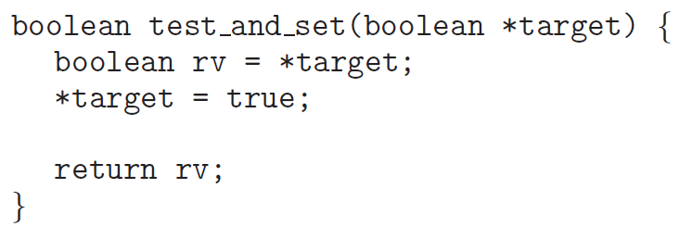
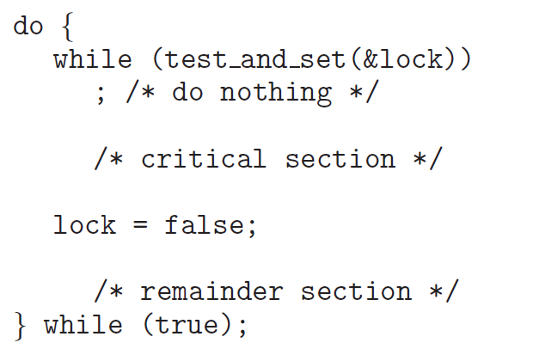
TEST_AND_SET( )
Executed atomically
Mutual exclusion can be implemented by initializing a Boolean variable lock to false

Slide 12
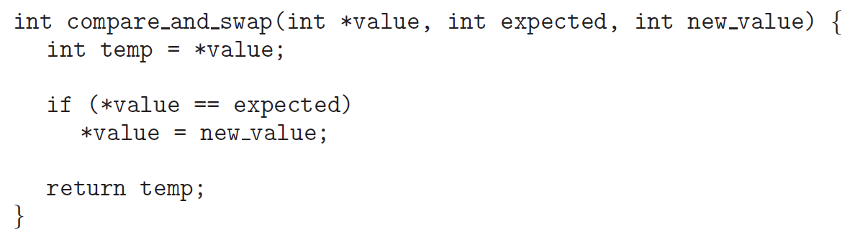
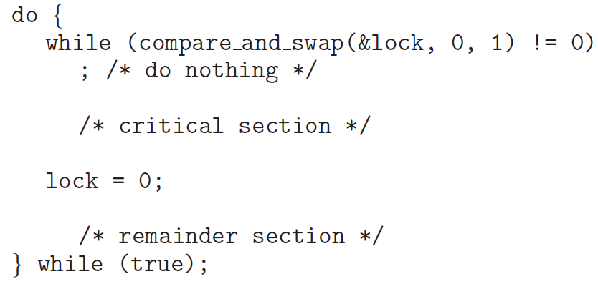
COMPARE_AND_SWAP( )
Mutual exclusion can be achieved by declaring a global variable lock and initializing it to 0
First process that invokes this instruction will set lock to 1 and no other process can execute CS until this process updates it to 0 after CS execution.

Slide 13
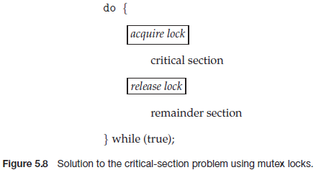
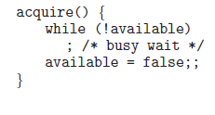

MUTEX LOCKS
Operating-systems designers build software tools to solve CS problem.
Simplest of these tools is “Mutex Lock” ( Mutex = Mutual Exclusion)
A process must acquire the lock before entering CS [ acquire() function ]
A process must release the lock after exiting the CS [ release() function ]
Mutex lock has a variable, available which indicates if the lock is available.

Slide 14
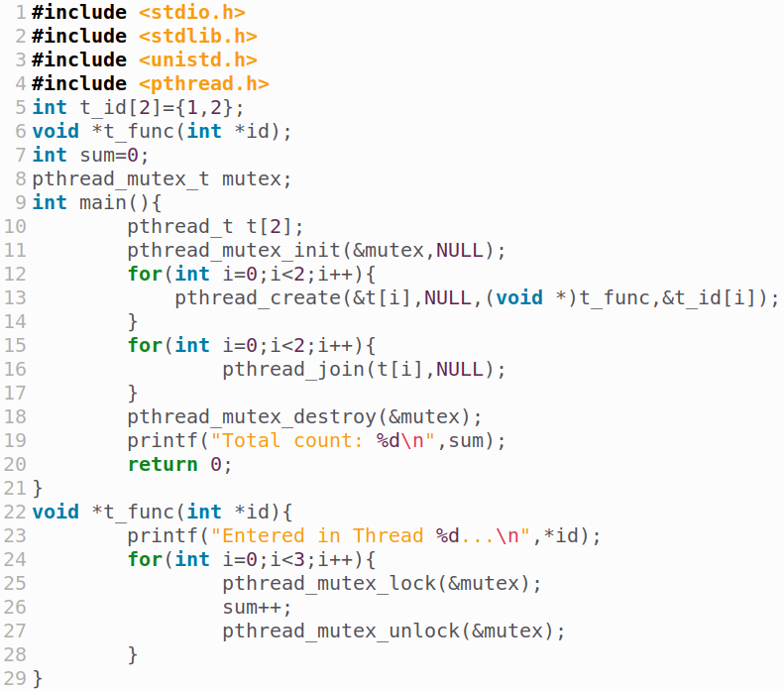

MUTEX IMPLEMENTATION
Output:
Declaring mutex variable
Initializing the mutex
Destroying the mutex after usage
Calling acquire func.
Calling release func.

Slide 15
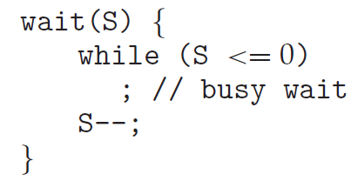
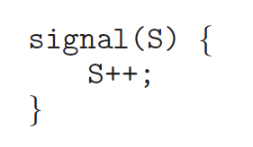
SEMAPHORE
A semaphore S is an integer variable
Is accessed only through two standard atomic operations: wait() and signal().
When one process modifies the semaphore value, no other process can simultaneously modify that same semaphore value.
In case of wait(S), the testing of the integer value of S (S ≤ 0), as well as its possible modification (S--), must be executed without interruption, i.e., this operations are atomic.

Slide 16
Types of Semaphores
Counting Semaphore: The value can range over an unrestricted domain.
Used to control access to a given resource consisting of finite number of instances
Solves various synchronization problems.
Binary Semaphore: The value can range only between 0 and 1. This behaves similar to Mutex Lock.

Slide 17
Counting Semaphore
initialized to the number of resources available, S = n
Each process that wishes to use a resource performs a wait() operation
S = S -1
When a process releases a resource, it performs a signal() operation
S = S +1
When S becomes 0, all resources are being used
processes that wish to use a resource will block until S>0

Slide 18
Binary Semaphore - Synchronization
P₁ has statement S₁
P₂ has statement S₂
We want to make sure that S₁ executes before S₂
We can use a semaphore variable sync and initialize it to 0
P1:
S1;
signal(sync);
P2:
wait(sync);
S2;

Slide 19
Mutual Exclusion With Semaphores
Binary Semaphores (mutex) can be used to solve CS problem.
A semaphore variable (say mutex) can be shared by n processes and initialized to 1.
Each process is structured as follows :
do{
wait (mutex);
//critical section
signal(mutex);
//remainder section
}while (TRUE);

Slide 20
OPERATING SYSTEMS
Semaphore Implementation
FBA

Slide 21
SEMAPHORE IMPLEMENTATION
Must guarantee that no two processes can execute the wait() and signal() on the same semaphore at the same time
Thus, the implementation becomes the critical section problem where the wait and signal code are placed in the critical section
Could now have busy waiting in critical section implementation
But implementation code is short
Little busy waiting if critical section rarely occupied
Note that applications may spend lots of time in critical sections and therefore this is not a good solution

Slide 22
SEMAPHORE IMPLEMENTATION
When a process executes the wait() operation and finds that the semaphore value is not positive, it must wait
Rather than this busy waiting, the process can block itself which places it into a waiting queue associated with the semaphore
State of the process is switched to the waiting state and control is transferred to CPU scheduler which selects another process to execute.
It will be restarted when some other process executes a signal() operation
Restarted by a wakeup() operation that changes it from waiting state to ready state.

Slide 23
SEMAPHORE IMPLEMENTATION
Definition of a semaphore:
typedef struct {
int value;
struct process *list;
} semaphore;
Definition of wait():
wait(semaphore *S) {
S->value--;
if (S->value < 0) {
add this process to S->list;
block();
}
}
Definition of signal():
signal(semaphore *S) {
S->value++;
if (S->value <= 0) {
remove a process P from S->list;
wakeup(P);
}
}

Slide 24
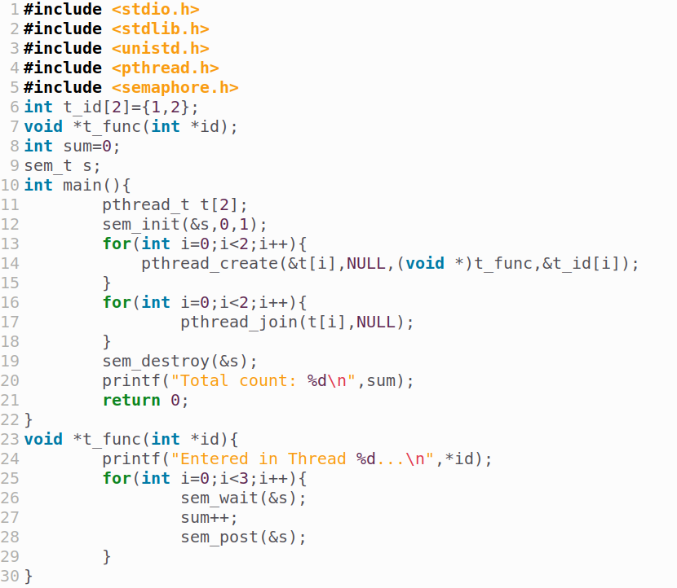

SEMAPHORE IMPLEMENTATION
Output:
Declaring semaphore variable
Initializing the semaphore
Destroying the semaphore after usage
Calling wait func.
Calling signal func.

Slide 25
OPERATING SYSTEMS
(Application of Semaphore)
Bounded Buffer Problem

Slide 26
Bounded Buffer Problem
Producer and Consumer share a fixed size buffer used as a queue
Producer generates piece of data and put it into the buffer and start again
Consumer removes data from the buffer
Concern 1: Producer won’t produce data when the buffer is full
Concern 2: Consumer won’t remove data when the buffer is empty

Slide 27
Inadequate Solution
procedure producer(){
while(true){
item = produceItem();
if(itemCount == BufferSize)
Sleep();
putIntoBuffer(item);
itemCount ++;
if(itemCount == 1)
wakeup(consumer);
}
}
procedure consumer(){
while(true){
if(itemCount == 0)
Sleep();
item = removeFromBuffer();
itemCount --;
if(itemCount == BufferSize - 1)
wakeup(producer);
}
}
DEADLOCK !!!
If, consumer is interrupted just after checking the itemCount value and before sleep() call, and producer produces an item it will call wakeup(). But, this call will be lost as no consumer in sleeping yet. And it will continue to produce items. Eventually, producer will sleep when the buffer is full. On the other hand, consumer will also stay in sleep as producer won’t call wakeup().

Slide 28
Deadlock & Starvation
Two or more process can wait indefinitely for an event - DEADLOCK !!!
It occurs because - two process depends on each other for causing an event in a specific manner
Starvation: Processes wait indefinitely within the semaphore
Occurs if we remove processes from the list associated with a semaphore in LIFO (last-in, first-out) order
P₀
wait(S);
wait(Q);
. .
. .
. .
signal(S);
signal(Q);
P₁
wait(Q);
wait(S);
. .
. .
. .
signal(Q);
signal(S);

Slide 29
Use of Semaphore for Solution
Solves the lost wakeup call by using two semaphore - countFill, countEmpty
countFill: number of available item in the buffer to be read
countEmpty: number of available space in the buffer to write
If producer tries to decrement countEmpty when it is 0, will be put to sleep
When an item is consumed, countEmpty will be incremented and producer wakes up.
Consumer works analogously.

Slide 30
Semaphore for multiple producer consumer
semaphore mutex = 1;
semaphore countFull = 0;
semaphore countEmpty = BUFFER_SIZE;
procedure producer(){
while(true){
item = producedItem();
wait(countEmpty);
wait(mutex);
putIntoBuffer(item);
signal(mutex);
signal(countFull);
}
}
procedure consumer(){
while(true){
wait(countFull);
wait(mutex);
item = removeFromBuffer();
signal(mutex);
signal(countEmpty);
consumeItem(item);
}
}

Slide 31
OPERATING SYSTEMS
(Application of Semaphore)
Reader-Writer Problem

Slide 32
Reader - Writer Problem
Data is shared among number of processes
Any number of readers may simultaneously read the data
Only one writer can write to the data
If a writer is writing, no reader can read
If at least one reader is reading, no writer can write to it
Readers only read, Writers only write
Variation of the problem:
First Variation: No reader will be kept waiting, unless a writer has got the permission to use the data, i.e., no reader should wait for other reader to finish
Second Variation: Once a writer is ready, the writer performs as soon as possible, i.e., no new readers can start reading.
Solution to either problem may create starvation -
First case: writer may starve
Second case: reader may starve

Slide 33
Solution to First Variation
Reader process has the following data structures -
semaphore rw_mutex = 1;
semaphore mutex = 1;
int read count = 0;
rw_mutex: common to both reader and writer, functions as mutual exclusion semaphore for writer
mutex: ensures mutual exclusion when read_count is updated
read_count: keeps track of how many processes are reading the object

Slide 34
Solution to First Variation
do {
wait( rw_mutex );
/* writing is performed */
signal( rw_mutex );
} while(true);
Writers
If a writer is in the critical section and n readers are waiting
One reader is queued on rw_mutex
Other n-1 readers are queued on mutex
When a writer executes signal(rw_mutex)
Resume the execution of either waiting readers or single waiting writer
Multiple process can acquire rw_mutex in read mode
Only one process can acquire rw_mutex in write mode
do{
wait( mutex );
read_count++;
if( read_count == 1)
wait( rw_mutex );
signal( mutex );
/* reading is performed */
wait( mutex );
read_count--;
if (read_count == 0)
signal( rw_mutex );
signal( mutex );
}while(true)
Readers

Slide 35

do {
wait( rw_mutex );
/* writing is performed */
signal( rw_mutex );
} while(true);
rw_mutex:
Writer
mutex:
read_count:
do{
wait( mutex );
read_count++;
if( read_count == 1)
wait( rw_mutex );
signal( mutex );
/* reading is performed */
wait( mutex );
read_count--;
if (read_count == 0)
signal( rw_mutex );
signal( mutex );
}while(true)
Readers
Shared File

Slide 36
OPERATING SYSTEMS
(Application of Semaphore)
Dining Philosophers Problem

Slide 37
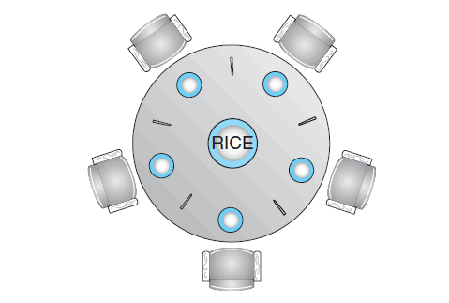
Dining-Philosophers Problem
In the center of the table is a bowl of rice, and the table is laid with five single chopsticks
From time to time, a philosopher gets hungry and tries to pick up the two chopsticks that are closest to her
When a hungry philosopher has both her chopsticks at the same time, she eats without releasing the chopsticks
When she is finished eating, she puts down both chopsticks and starts thinking again

Slide 38
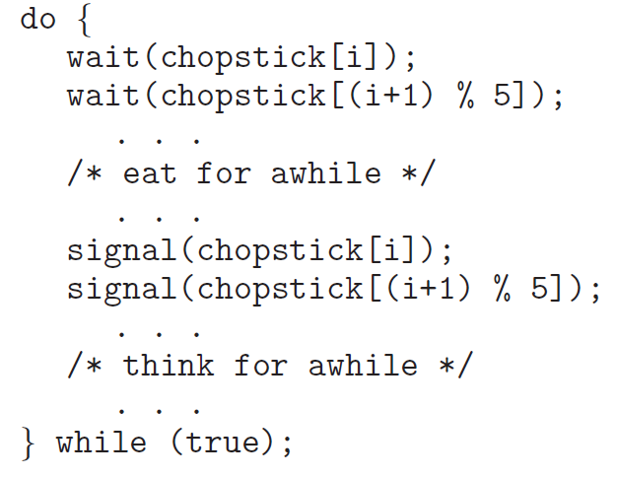
Solution to the problem
One of the simple solution is to use 5 semaphores for 5 chopsticks.
semaphore chopstick[5];
Structure of i^{th} philosopher’s process can be -
3
2
3
4
2
4
0
1
1
0

Slide 39

BUT GUESS WHAT’S COMING????
3
2
3
4
2
4
0
1
1
0
If all the philosophers are hungry at the same time and grab their left chopstick by calling wait(chopstick[i]), No one will ever find a second chopstick for eating. Consequently, they will die from starvation :P

Slide 40

How to prevent deadlock in this solution?

Slide 41
How to prevent deadlock in this solution?
Allow at most four philosophers to be sitting simultaneously at the table
Allow a philosopher to pick up her chopsticks only if both chopsticks are available (to do this, she must pick them up in a critical section).
Use an asymmetric solution — that is, an odd-numbered philosopher picks up first her left chopstick and then her right chopstick, whereas an even-numbered philosopher picks up her right chopstick and then her left chopstick.

Slide 42
Necessary Conditions for Deadlock
Necessary conditions for deadlocks are -
Mutual Exclusion
Hold and Wait
No Preemption (cannot force to release the resource)
Circular wait
If one of these are not present in a system, then the system is “Deadlock Free”.

